Slide 1
Planning for Power Issues
And ‘things that go pfffffff in the night’

Slide 2
Who am I
Oli Stockman – Managing Director of N G A Connect and Fram Broadband
N G A Connect – Niche/boutique connectivity, wholesale and network architecture/planning
Fram Broadband – WISP and now localised LLU operator

Slide 3
Designing High-Autonomy Backup Power
Running networks ‘off the beaten track’ requires backup supplies that run for a minimum of 4 hours
Why? It normally takes that long to scramble someone with a generator for an extended outage
Always mount them somewhere that’s always accessible
We previously used off-the-shelf AC UPS’ from a major manufacturer – no longer fit for purpose

Slide 4
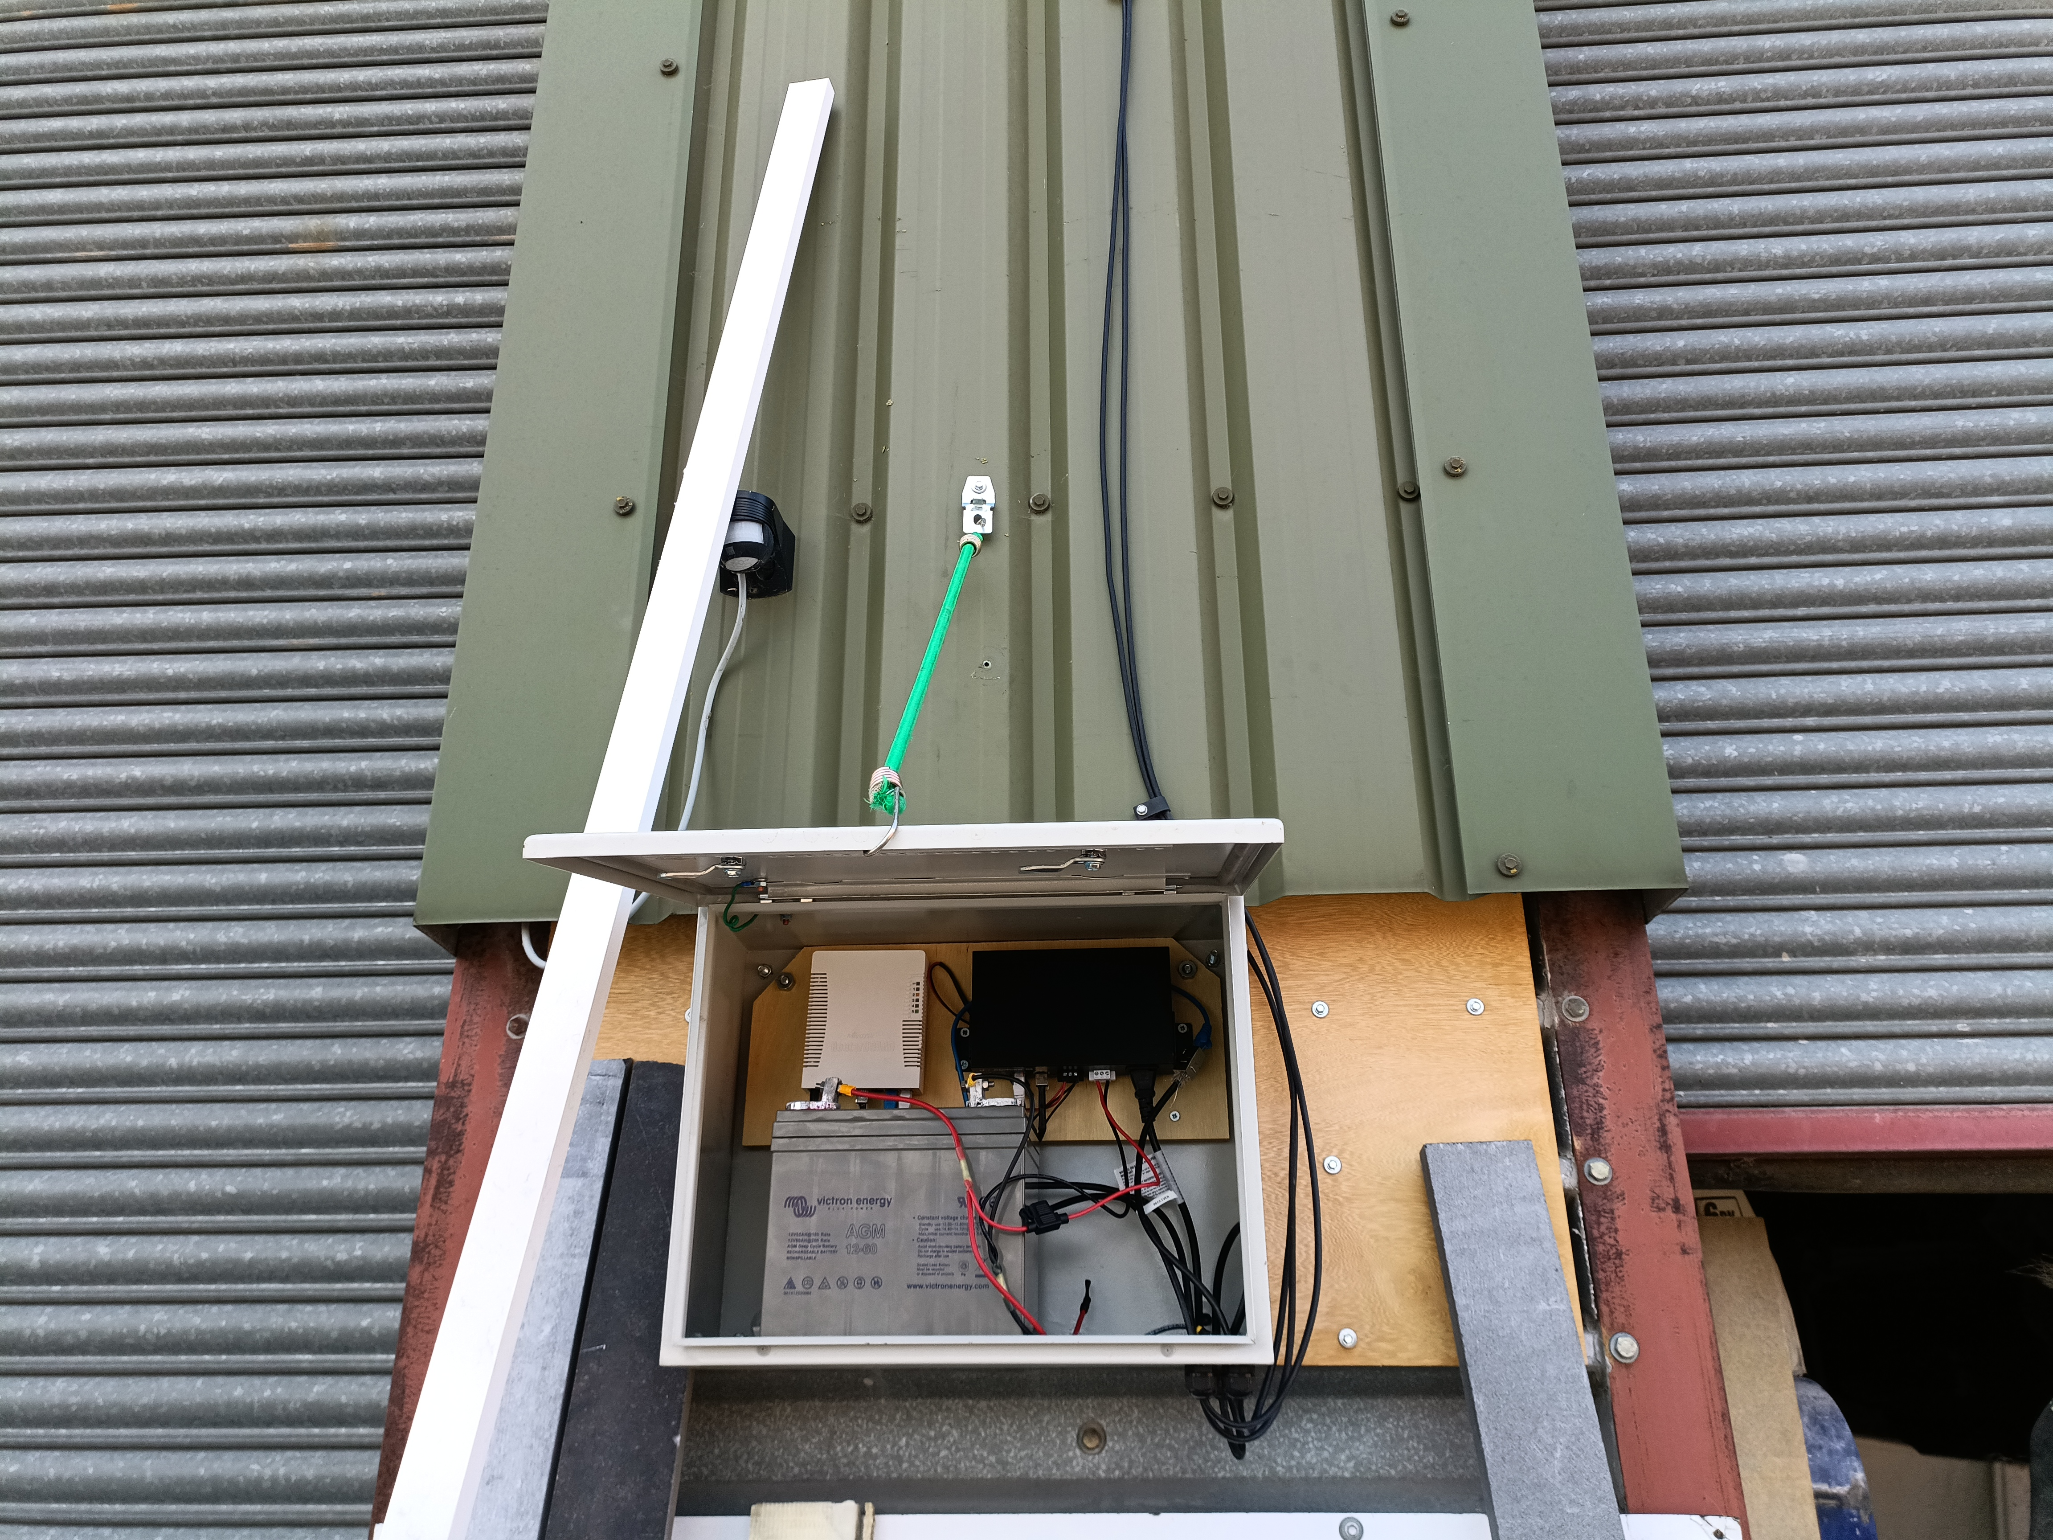
Examples
Micro-relay site – 12v DC battery, 24v POE

Slide 5
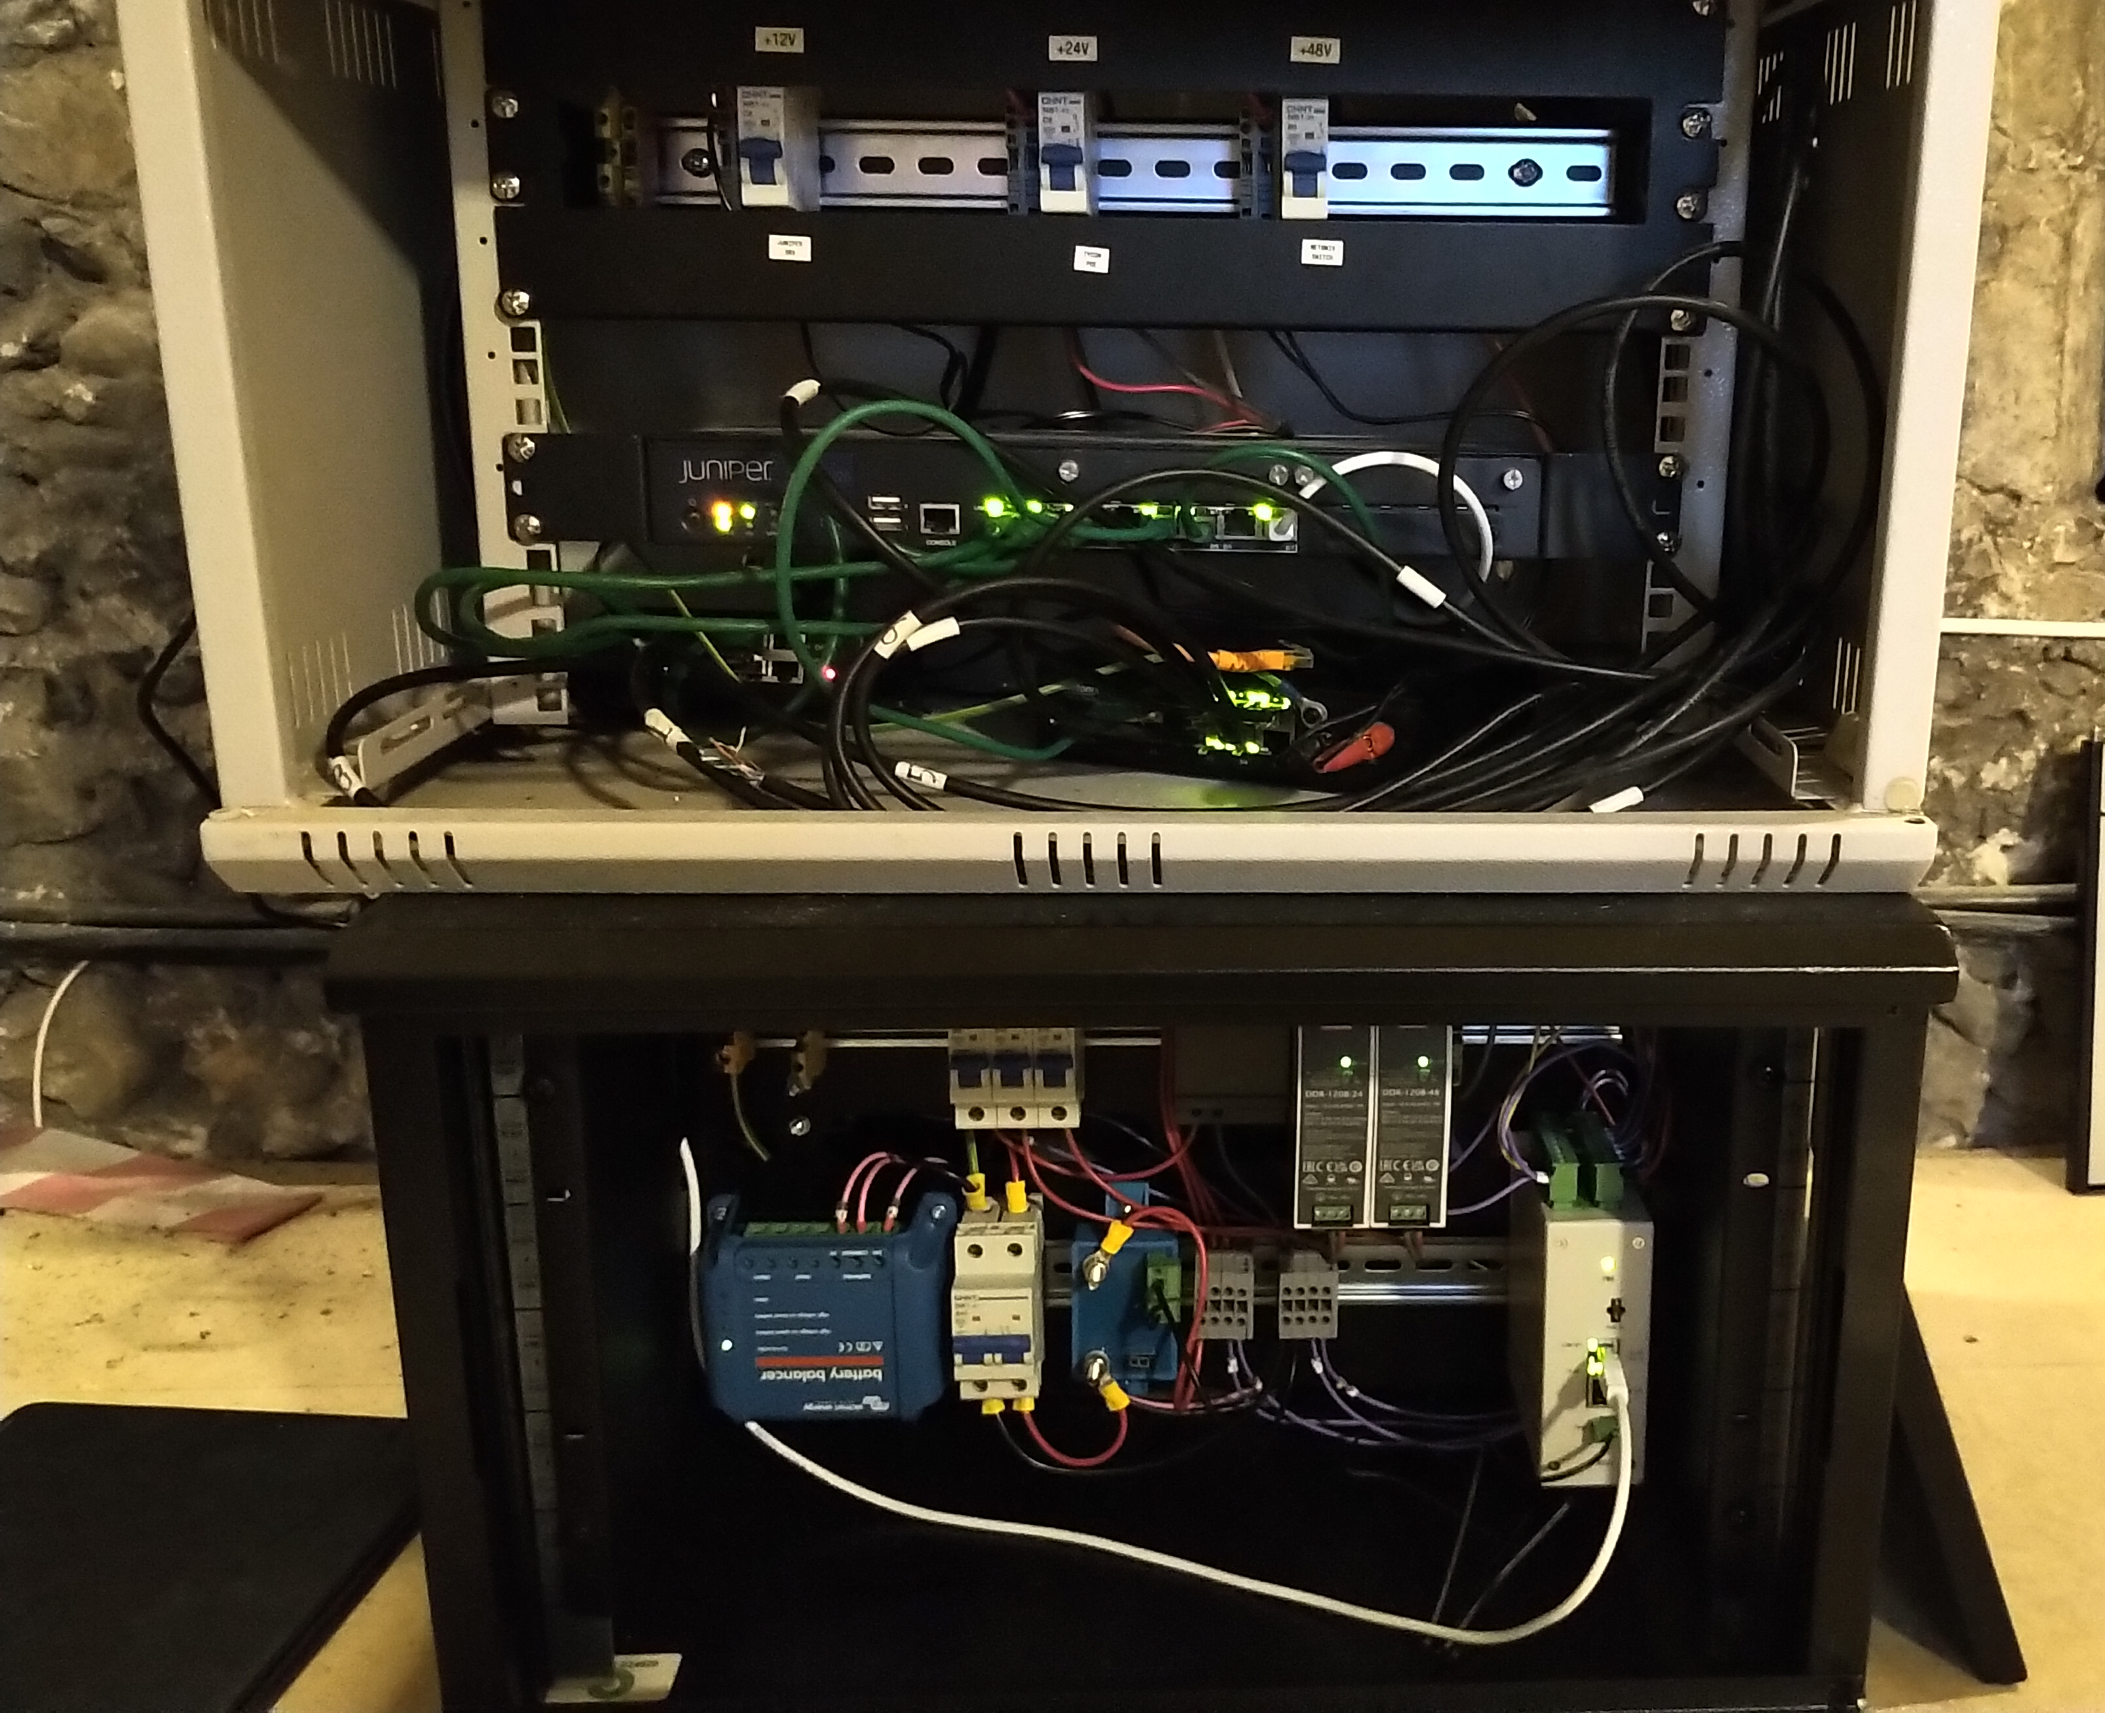
Examples
Primary Site – 24v DC battery

Slide 6
Why make them accessible
What happens in an extreme extended outage………….

Slide 7
Things we learned
We had the opportunity to hyper-optimize
Always fit quick-release connectors to battery strings and mains inputs
Think about keeping equipment dry in the rain
Think about keeping things accessible when changing heavy batteries
Always have charged spares

Slide 8
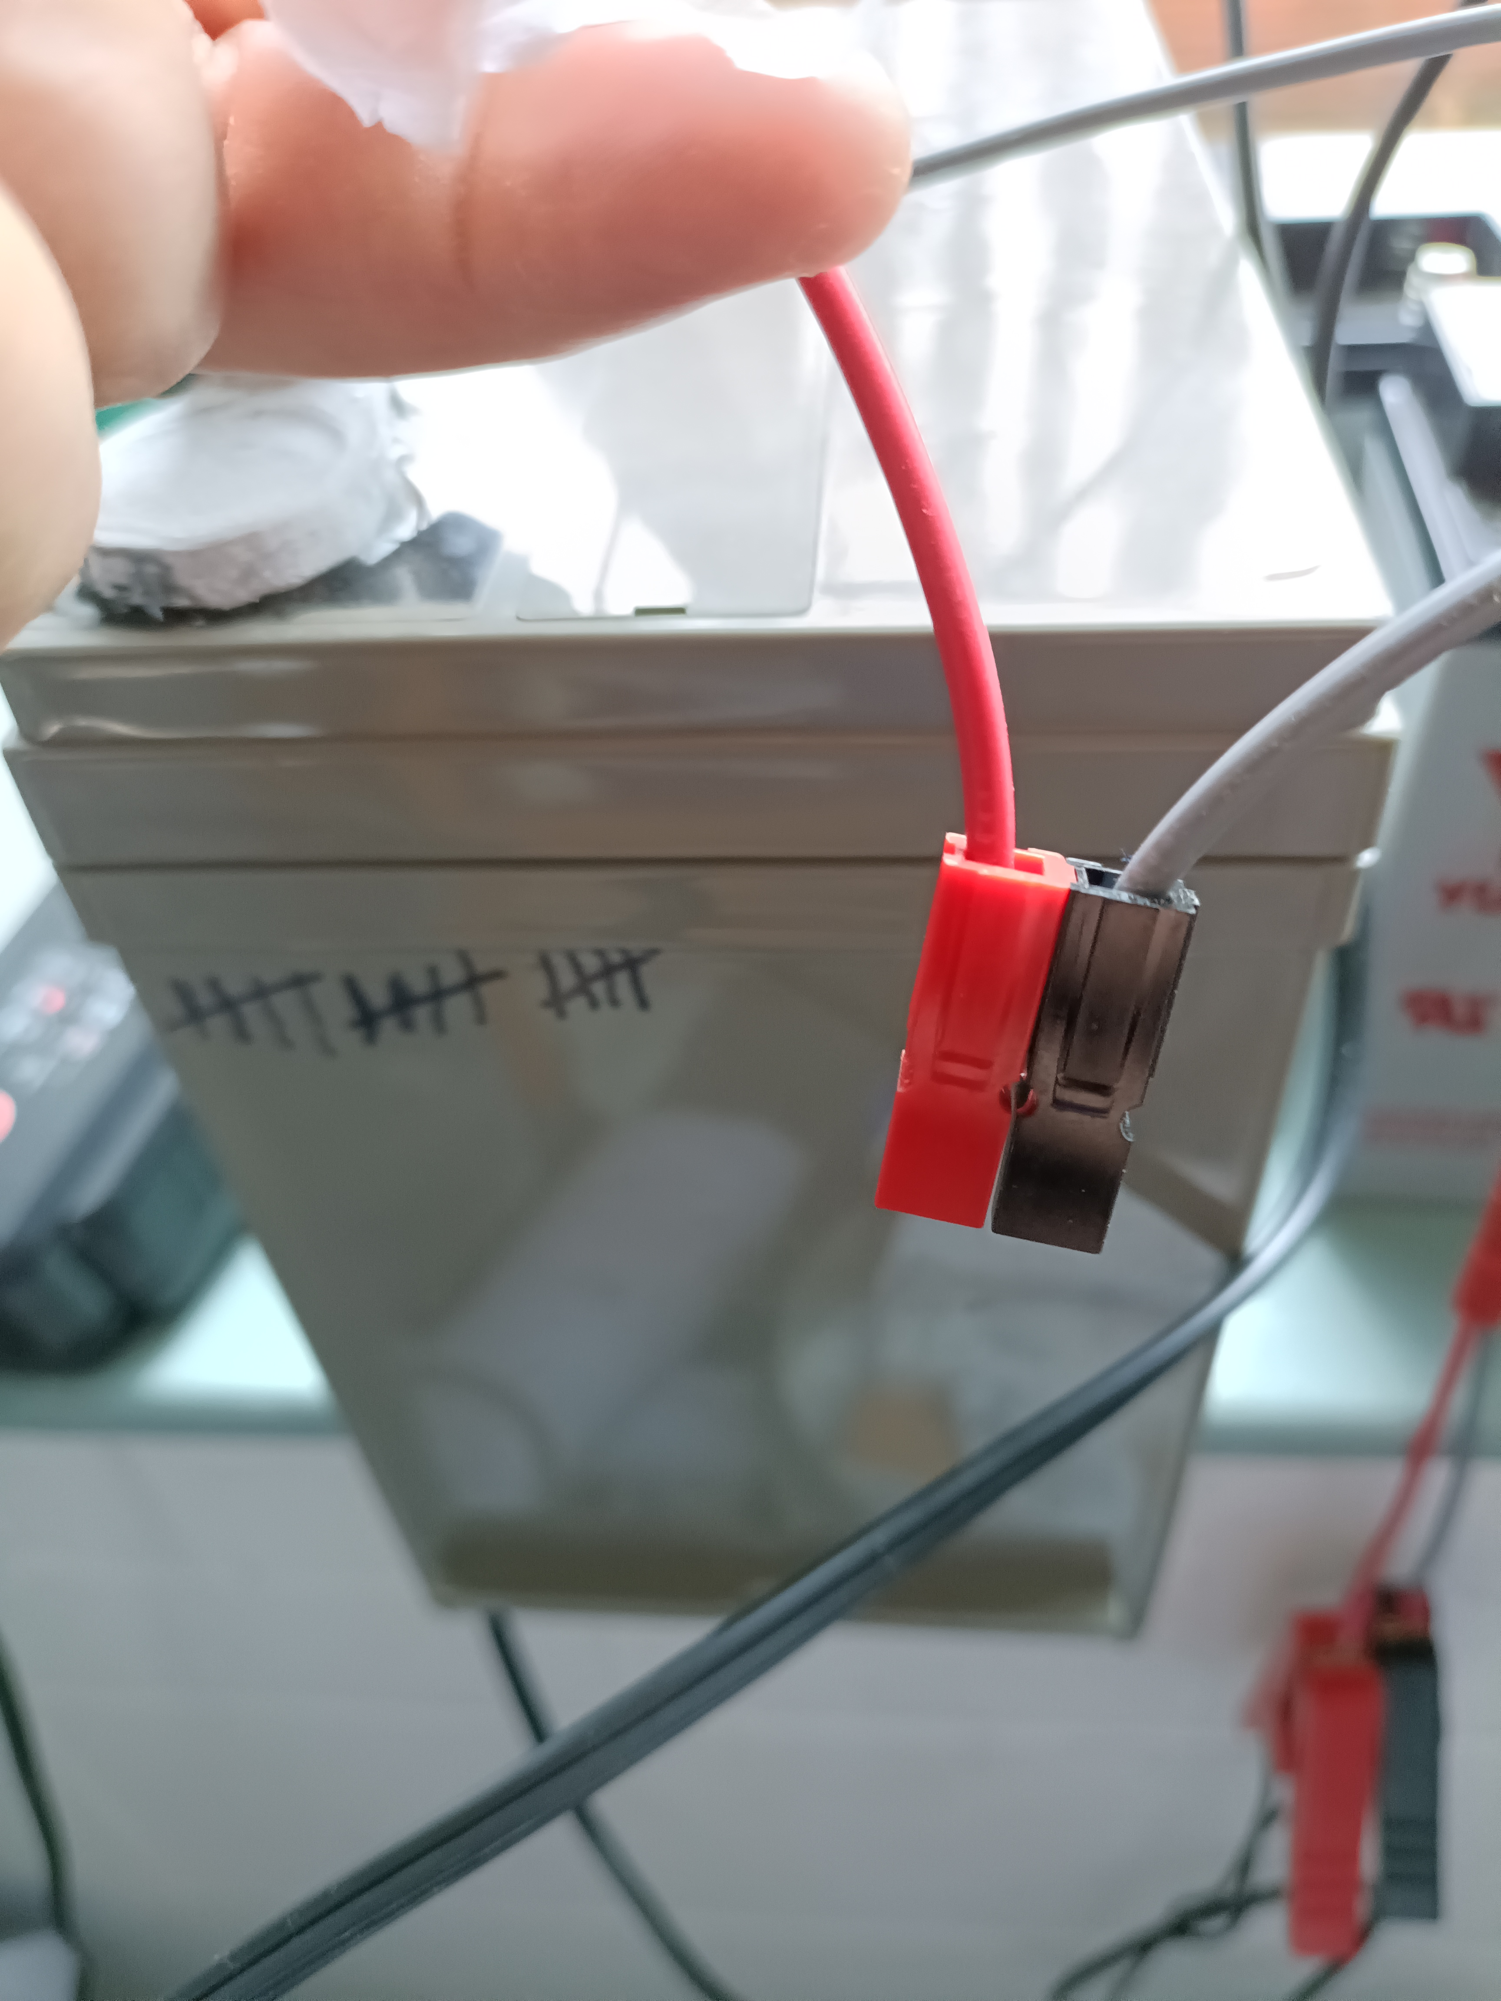

Slide 9
Things that go pffff in the night
Why is our exchange rack door open?
The right place at the right time….

Slide 10
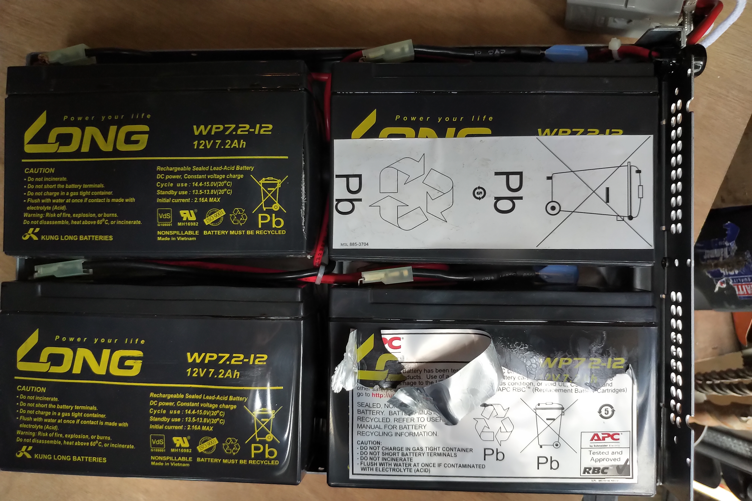
Ooooof…..

