Slide 1
Root KSK Rollover 2026
An Operator’s Readiness Checklist
Roy Arends, ICANN
David Groves, Nominet
NetLDN, October 2026.

Slide 2
Why You Should Care
DNSSEC validation depends on root trust anchor
  The root has been signed since 2010
  First rollover since 2018
  Second rollover since the start
This is a planned, routine event
Your job: make sure your resolvers follow along
ICANN intent is to rollover ever 3 years.

Slide 3
What changes on Sunday.
$ dig +short @a.root-servers.net -t DNSKEY .
# KSK-2017 (Key Signing Key) - Key Tag 20326 - RETIRING
257 3 8 AwEAAaz/tA...R1AkUTV74bU=
# KSK-2024 (Key Signing Key) - Key Tag 38696 – NEW TRUST ANCHOR
257 3 8 AwEAAa96je...eayffKC73PYc=

Slide 4
What actually changes.
The RRSIG records that sign the DNSKEY set on the root.
They will change from being signed by the 2017 KSK to the 2024 KSK.
Thus if you don’t trust the 2024 KSK, you fail to validate it.

Slide 5
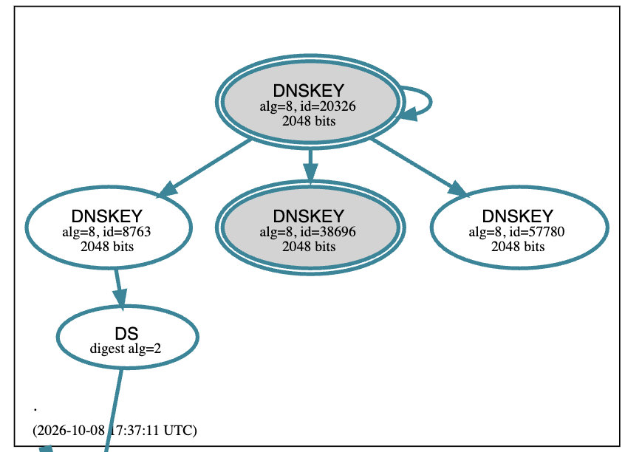

Slide 6
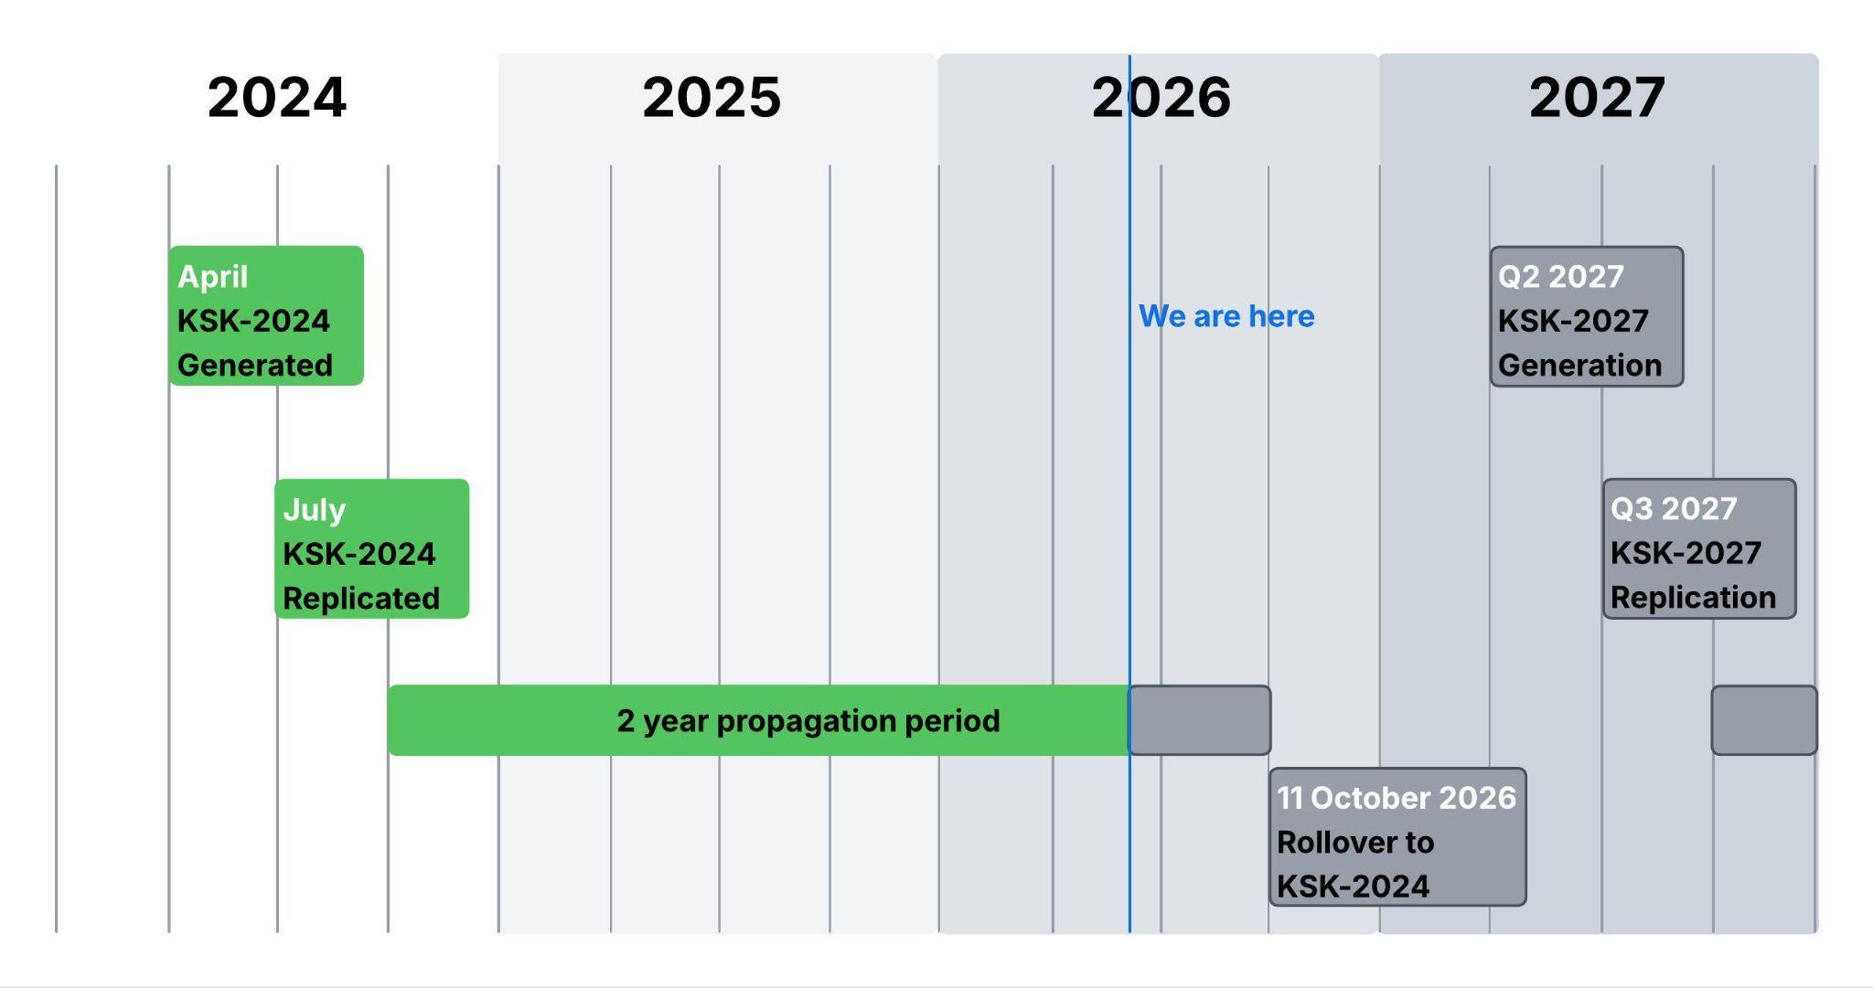
Timeline
Notes:
In April 2024, a new KSK was generated in the key signing ceremony.
In July 2024, the KSK was backed up and repliated to the secondary key signing site.
There has been 2 years with this key in the system, and records signed with both keys.

Slide 7
How do I get the new root key anchors ?
By updating your DNS resolver software.
By updating your operating system packages.
Via the RFC 5011 process.

Slide 8
Check if your software is up to date
Resolver | First Release with KSK-2024 | RFC 5011 | Key File
Unbound | 1.21.0 (August 15, 2024) | Yes | root.key
Knot Resolver | 5.7.4 / 6.0.8 (Late 2024) | Yes | root.keys
BIND | 9.18.33 / 9.20.4 (January 2025) | Yes | bind.keys / managed-keys.bind
PowerDNS Recursor | 5.2.0-alpha1 (Nov 11, 2024) / 5.2.0 (Jan 14, 2025) | No | Built-in only

Slide 9
Linux Distributions.
Some Linux distributions distribute root DNS data via a package.
For example, Debian and derived distros do so in dns-root-data.
This contains.
  The root hints.
  The root trust anchor.

Slide 10
How does RFC 5011 work
Continuous Tracking: Resolvers constantly monitors the DNS root zone to see what keys are published and use the currently trusted key (KSK2017) to verify them.
The Introduction: KSK2024 is published signed by KSK2017. The resolver detects it but places it into a "Add" state rather than trusting it immediately.
30-Day Hold-Down: A 30-day countdown timer begins; KSK2024 must remain continuously present and stable in the root zone for this entire period.
Achieving Trust: Once the 30 days pass with no interruptions, the resolver automatically updates its local database, officially upgrading KSK2024 to a trusted "Valid" status. It can now be used to sign the ZSK for the root.
Retiring the Old Key: When the operator flips a special "Revoked" flag on KSK2017, the resolver detects this and automatically deletes the old key, completing the hands-free transition.

Slide 11
RFC 5011 Happy Path Timeline.
January 11, 2025: DNSKEY KSK-2024 was added to root zone
February 10, 2025: 30 days elapsed
KSK-2024 should be trusted via 5011
October 11, 2026: KSK-2024 will start signing
KSK-2017 will stop signing
January 11, 2027: KSK-2017 is scheduled to be revoked

Slide 12
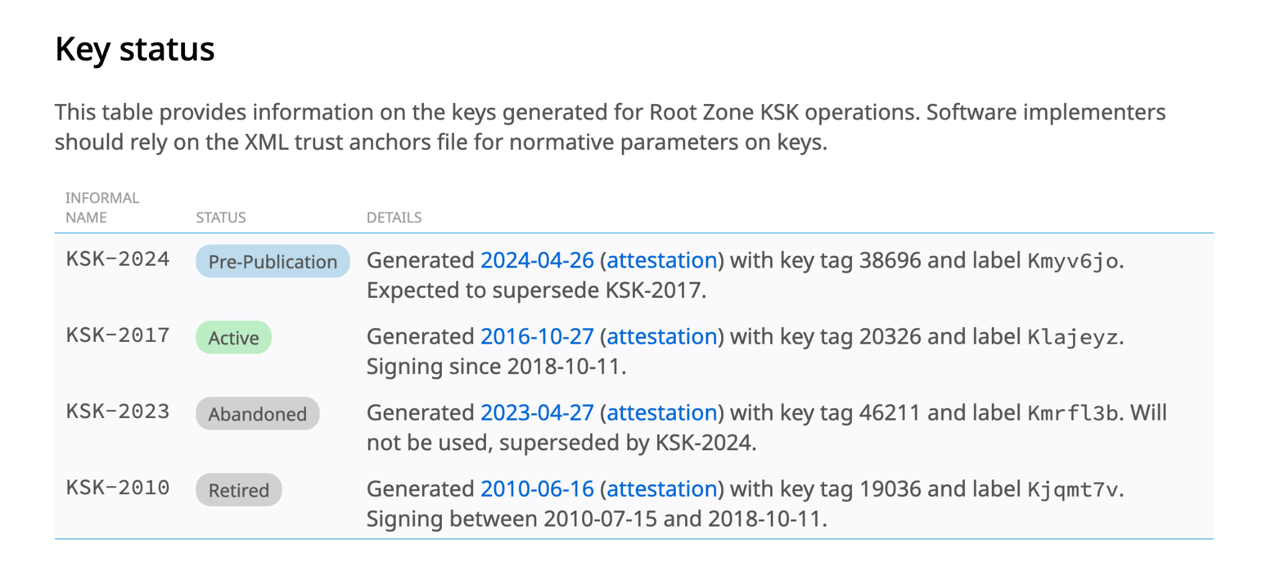
Out of Band Distribution.
https://www.iana.org/dnssec/files

Slide 13
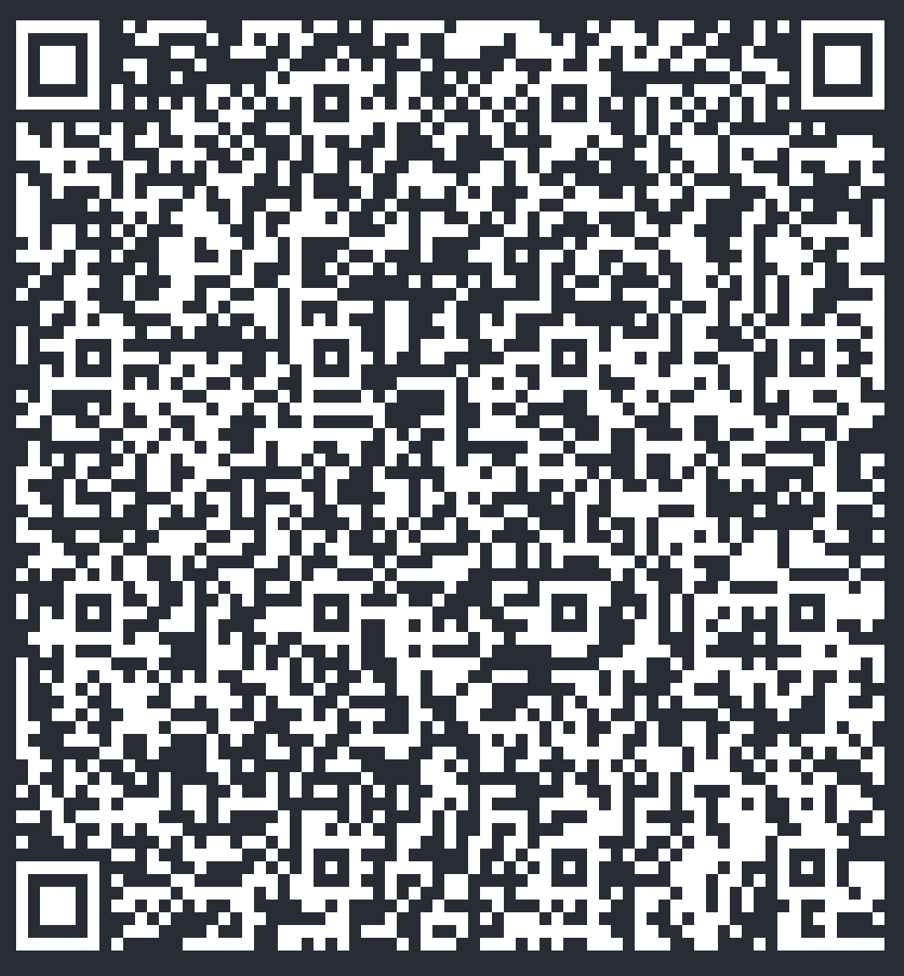
Use your phone distribution

Slide 14
What should you do ?
If you operate a recursive resolver.
  Be a good internet citizen, have it validate DNSSEC !
  Check it trusts KSK-2024 BEFORE 11 October.
  BIND: rndc secroots and check file produced.
  UNBOUND: Check trust-anchor-file in config.
  KNOT: kresdctl tty 'trust_anchors.summary()'
If you don’t.
  If your DNS resolution breaks on or around 11 October, think of this presentation !

Slide 15
Registry Standardisation.
The UK was the first ccTLD on the internet.
It had to do many things before standards existed.
It has drifted from the “new normal”.
This makes .UK more like other TLD’s including gTLD’s, and .cyrmu.
If you are a UK domain registrar, you have to make changes.

Slide 16
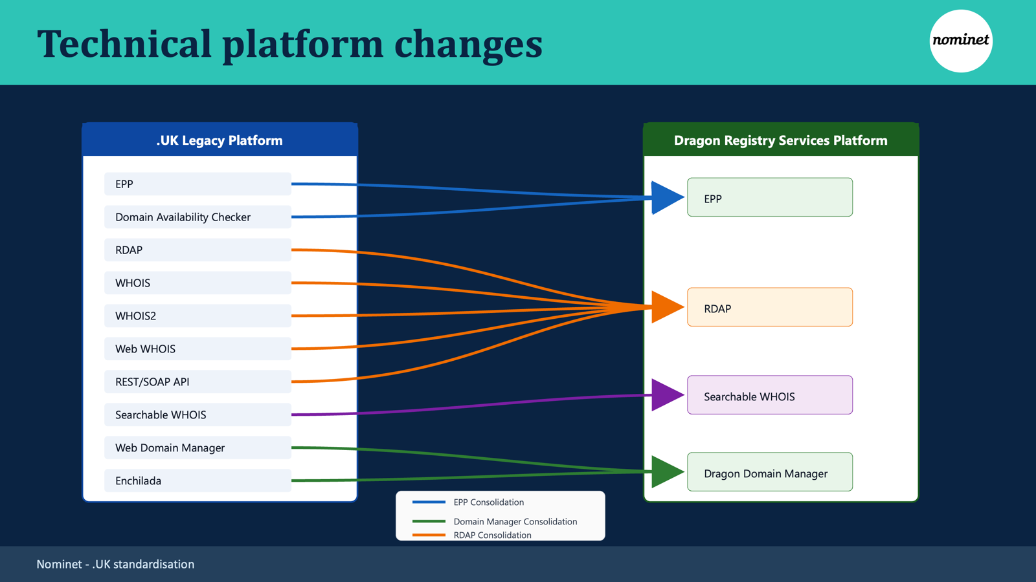

Slide 17
Major Changes.
New UK lifecycle
WHOIS retired
Standard EPP Inter-registrar transfer process aligned with future state of gTLD process.
STAC: Secure Transfer Authorisation Codes
EPP lock status
Updated EPP poll notifications
Fees extension 1.0 (RFC8748)
Reseller support
  EPP organisation objects and extension
  RDAP publication of reseller information.
Credentialled RDAP search
  (replacing SOAP and REST API)

Slide 18
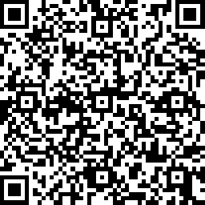
More Info And When.
https://registrars.nominet.uk/registry/dot-uk/preparing-for-standardisation/
Cutover Date: Tuesday 9th February 2027.

